Slide 1
Chapter 23: Managing Architecture Debt
Some debts are fun when you are acquiring them, but none are fun when you set about retiring them. —Ogden Nash

Slide 2
Chapter Outline
Managing Architecture Debt
Determining Whether You Have an Architecture Debt Problem
Discovering Hotspots
Example
Automation
Summary

Slide 3
Architecture Debt
Without careful attention, designs become harder to maintain and evolve over time.
We call this form of entropy “architecture debt,” and it is an important and highly costly form of technical debt.
Architecture debt can be removed through refactoring.

Slide 4
Architecture Debt
The debt identification process requires three types of information:
Source code. This is used to determine structural dependencies.
Revision history, as extracted from a project’s version control system. This is used to determine the co-evolution of code units.
Issue information, as extracted from an issue control system. This is used to determine the reason for changes.

Slide 5
Determining Whether You Have an Architecture Debt Problem
How to we determine if a group of files is architecturally connected?
identify the static dependencies between the files in your project using a static code analysis tool.
capture the evolutionary dependencies between files in a project. An evolutionary dependency occurs when two files change together, and you can extract this information from your revision control system.

Slide 6
Determining Whether You Have an Architecture Debt Problem
We represent file dependencies using a design structure matrix (DSM).
Files are placed on the rows of the matrix and, in the same order, on the columns.
The cells of the matrix are annotated to indicate the type of dependency.

Slide 7
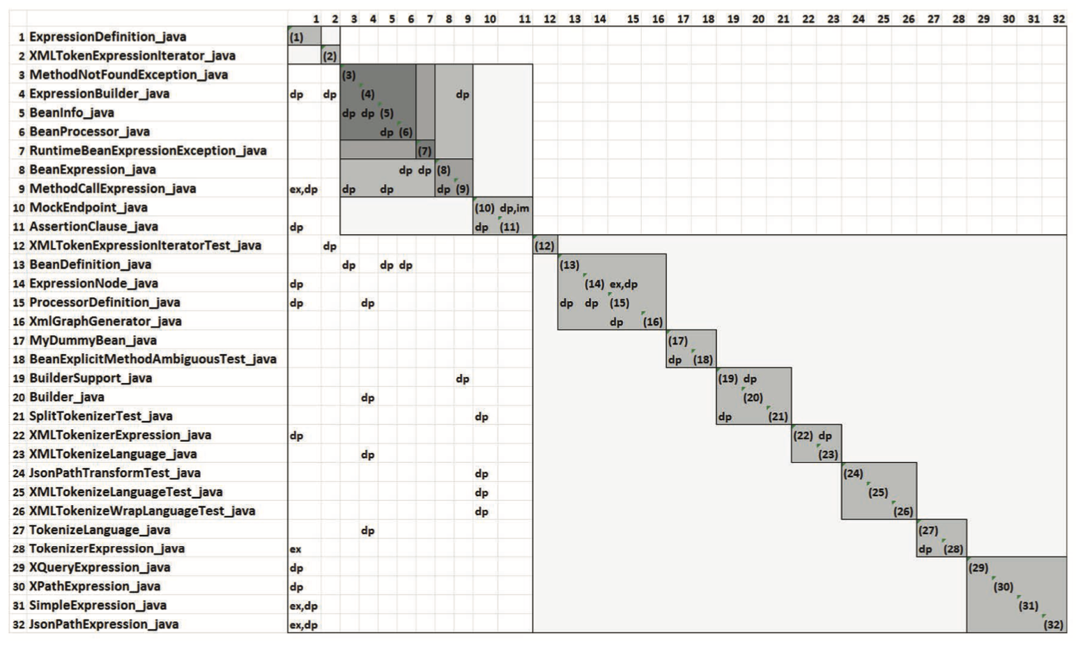
Example DSM from Apache Camel

Slide 8
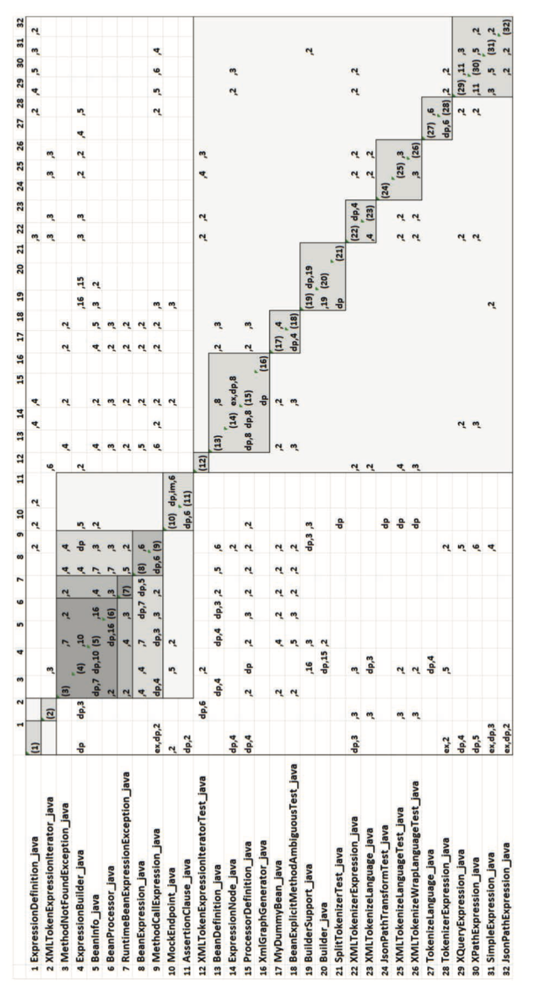
Example DSM with Co-Change Information

Slide 9
Discovering Hotspots
To target architecture debt you need to identify the specific files and their flawed relationships.
We call the sets of elements that make outsized contributions to the maintenance costs of a system hotspots.
To identify hotspots, we look for anti-patterns that contribute to high coupling and low cohesion.

Slide 10
Discovering Hotspots
Six common anti-patterns that lead to debt:
Unstable interface
Modularity violation
Unhealthy inheritance
Cyclic dependency or clique
Package cycle
Crossing

Slide 11
Unstable Interface
An influential file—one representing an important service, resource, or abstraction—changes frequently with its dependents, as recorded in the revision history.
The “interface” file is the entry point for other system elements to use the service or resource.
It is frequently modified due to internal reasons, changes to its API, or both.
To identify this anti-pattern, search for a file with a large number of dependents that is modified frequently with other files.

Slide 12
Modularity Violation
Structurally decoupled modules frequently change together.
To identify this anti-pattern, search for two or more structurally independent files—that is, files that have no structural dependency on each other—that change together frequently.

Slide 13
Unhealthy Inheritance
A base class depends on its subclasses or a client class depends on both the base class and one or more of its subclasses.
To determine unhealthy inheritance instances, search for either of the following in a DSM:
In an inheritance hierarchy, a parent depends on its child class.
In an inheritance hierarchy, a client of the class hierarchy depends on both the parent and one or more of its children.

Slide 14
Cyclic Dependency or Clique
A group of files is tightly connected.
To identify this anti-pattern, search for sets of files that form a strongly connected graph, where there is a structural dependency path between any two elements of the graph.

Slide 15
Package Cycle
Two or more packages depend on each other, rather than forming a hierarchical structure, as they should.
Detecting this anti-pattern is similar to detecting a clique: A package cycle is determined by discovering packages that form a strongly connected graph.

Slide 16
Crossing
A file has both a high number of dependent files and a high number of files on which it depends, and it changes frequently with its dependents and the files it depends on.
To determine the file at the center of a crossing, search for a file that has both high fan-in and fan-out and substantial co-change relations with other files.

Slide 17
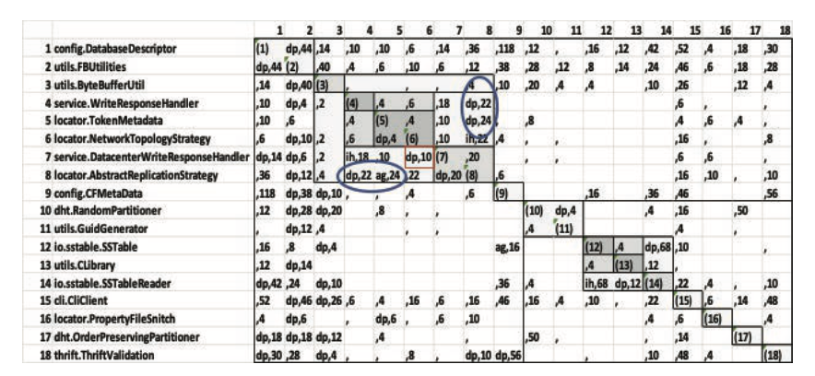
Clique in Apache Cassandra

Slide 18
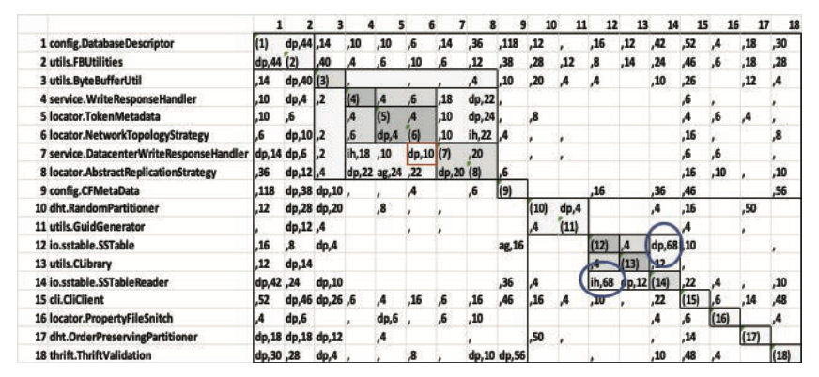
Unhealthy Inheritance in Apache Cassandra

Slide 19
Fixing Hotspots
Most issues in an issue tracking are either bug fixes or feature enhancements.
Bug fixes and both bug-related and change-related churn are highly correlated with anti-patterns and hotspots.
We can assign a penalty to each anti-pattern using this information.

Slide 20
Fixing Hotspots
With this analysis a debt-reduction strategy (through refactoring) is straightforward.
Knowing the files implicated in the debt, along with their flawed relationships (as determined by the identified anti-patterns), allows the architect to fashion and justify a refactoring plan.
If a clique exists, for example, a dependency needs to be removed or reversed, to break the cycle of dependencies.
If unhealthy inheritance is present, some functionality needs to be moved, typically from a child class to a parent class.
If a modularity violation is identified, the unencapsulated “secret” shared among files needs to be encapsulated.
And so forth.

Slide 21
Example – SS1
This case study, which we call SS1, was done with SoftServe, a multinational software outsourcing company.
At the time of the analysis, SS1 had 797 source files, and we captured its revision history and issues over a two-year period.
SS1 was maintained by six full-time developers and many more occasional contributors.

Slide 22
SS1 Analysis
2,756 issues were recorded in SS1's Jira issue-tracker (1,079 of which were bugs)
3,262 commits were recorded in the Git version control repository.
Three clusters of files (291 files out of 797 in the project) were identified as containing the most harmful anti-patterns and hence the most debt.
The number of defects associated with these three clusters covered 89 percent of the project’s total defects (265 in a year).

Slide 23
SS1 Analysis
We calculate the cost of these debts in terms of the lines of code committed for bug fixes as follows:
The architect estimated the effort required to refactor the three hotspots as 14 person-months.
We calculated the average bug fixes per file annually for the project as 0.33.
We calculated the average number of annual bug fixes for files in hotspots as 237.8.
Based on these results, we estimated that the annual number of bug fixes for the files in the hotspots, after refactoring, would be 96.
The difference between the actual churn associated with the hotspot files and the expected amount of churn after refactoring is the expected savings.
The estimated annual savings for the refactored files (using company average productivity numbers) was 41.35 person-months.
Considering the calculations in steps 1–5, we see that for a cost of 14 person-months, the project can expect to save more than 41 person-months annually.

Slide 24
Tool Support
This analysis process requires the following tools:
A tool to extract a set of issues from an issue tracker
A tool to extract a log from a revision control system
A tool to reverse-engineer the code base, to determine the syntactic dependencies among files
A tool to build DSMs from the extracted information and walk through the DSM looking for the anti-patterns
A tool that calculates the debt associated with each hotspot
The only specialized tools needed for this process are the ones to build the DSM and analyze the DSM. We used DV8 (www.archdia.com).
Projects likely already have issue tracking systems and revision histories, and plenty of reverse-engineering tools are available, including open source options.

Slide 25
Summary
Architecture debt is an important and costly form of technical debt. Compared to code-based technical debt, architecture debt is harder to identify because its root causes are distributed among several files and their relationships.
The process involves gathering information from the project’s issue tracker, its revision control system, and its source code.
Architecture anti-patterns can be identified and grouped into hotspots, and the impact of these hotspots can be quantified.
This architecture debt monitoring process can be automated and built into a system’s continuous integration tool suite.
xOnce architecture debt has been identified, if it is bad enough, it should be removed through refactoring.
The output of this process provides the quantitative data necessary to make the business case for refactoring to project management.

